Slide 1
Chapter 4
Frequency Analysis and Descriptive Statistics

Slide 2
Learning Objectives
Describe the meaning of frequency and measures of central tendency, percentiles, quartiles, dispersion and distribution
Discuss how to compute and display frequency by using different charts and graphs for metric and non-metric data
Explain how to compute percentiles, central tendency, dispersion and distribution
Demonstrate the steps used in SPSS for preparing a bar chart, a pie chart and a histogram, aiming to display the frequency and central tendency
Explain how to select a variable along with a relevant scale for frequency analysis and descriptive statistics.

Slide 3
Executing Frequency with SPSS
Displaying Frequencies by Using a Bar Chart
A bar chart is the simplest way to display frequency for a specific number of categories of a nominal scale variable. The frequency of variables based on non-metric (nominal or categorical) scale is often presented in the form of a bar chart.
Exhibit 4.1. Use retail.sav » Menu bar » analyse » Descriptive Statistics » Frequencies » Select Occupation and transfer to right-handed variable(s) box » Chart » Bar chart » Click OK

Slide 4
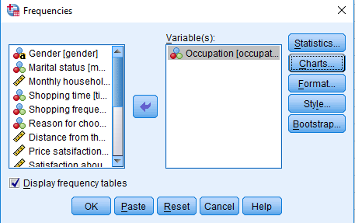
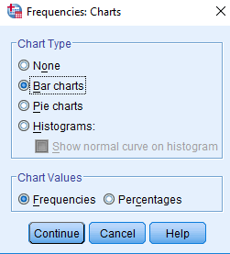

Slide 5
Table 4.1. Frequency Table of Occupation
Occupation | Frequency | Percentage | Valid Percentage | Cumulative Percentage
Business | 36 | 30.0 | 30.0 | 30.0
Government employee | 22 | 18.3 | 18.3 | 48.3
Private employee | 31 | 25.8 | 25.8 | 74.2
Students | 16 | 13.3 | 13.3 | 87.5
Housewife | 15 | 12.5 | 12.5 | 100.0
Total | 120 | 100.0 | 100.0

Slide 7
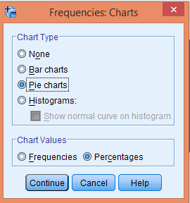
Displaying Frequency by Using a Pie Chart
A pie chart displays the categories which are proportionate to the total area, considering it to be 100%. Different categories of a variable are presented on percentage basis rather than on an absolute basis; hence, larger proportion of categories is shown by the larger pies in the chart.

Slide 8
Position of the Slices
Figure 4.1a. Clockwise 12:00 Position | Figure 4.1b. Clockwise 01:00 Position
Figure 4.1c. Anticlockwise 12:00 Position | Figure 4.1d. Anticlockwise 01:00 Position

Slide 9
Displaying Frequency by Using a Histogram
A histogram is generally used to compute frequency of different categories in case of dealing with large number of discrete or continuous data.
Exhibit 4.2. Use retail.sav » Menu bar » analyse » Descriptive statistics » Frequencies » Select Distance and transfer to right-handed variable(s) box » Chart » Histogram » Click OK

Slide 10
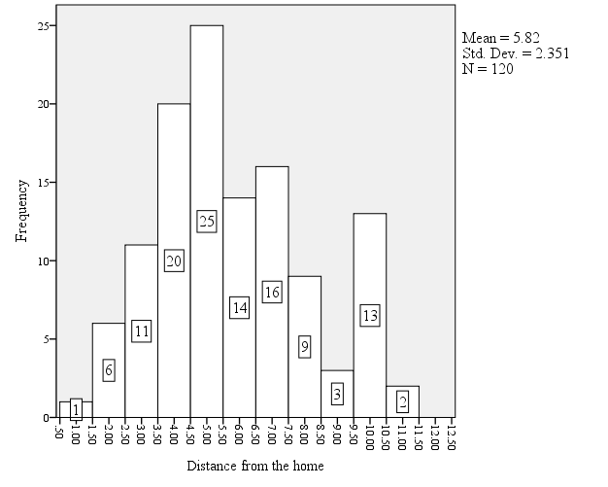

Slide 11
Editing Histograms with Altering Bins and Scales
Changing the width of bins is the main task performed in the process of editing. Binning refers to grouping the individual data into class intervals.
Exhibit 4.3. Double click on Histogram at output window » Chart Editor » Click on the x-axis of histogram » Click on Scale option available at Properties dialog box » Assign value in Major Increment box (from 1.0 to 3.0) in the Custom range column » Close the Properties box and Chart Editor box

Slide 12
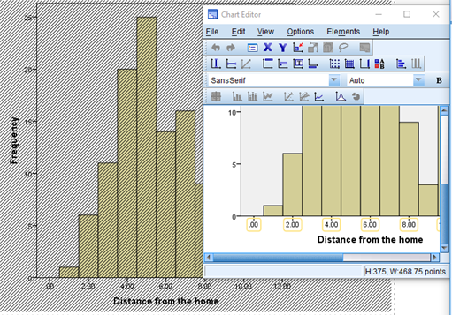
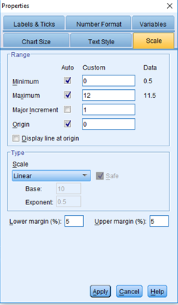

Slide 13
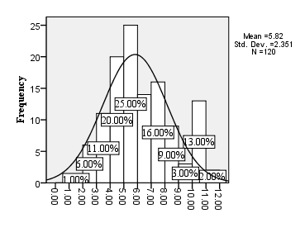
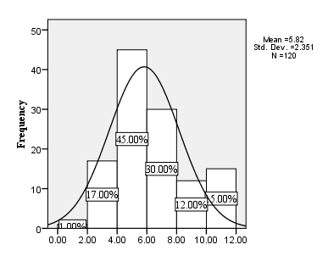
Customized Histogram
Figure 4.2a. Major Increment 1.0 | Figure 4.2b. Major Increment 2.0

Slide 14
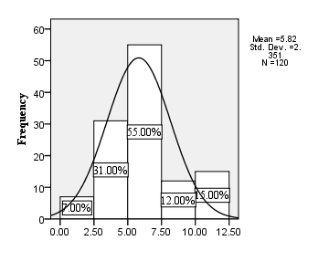
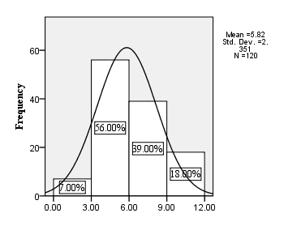
Figure 4.2c. Major Increment 2.5 | Figure 4.2d. Major Increment 3.0

Slide 15
Formats of Frequency Analysis
The frequencies of various categories of a nominal scale variable can also be portrayed either in ascending or descending order by using the option available in frequencies format.
Exhibit 4.4. SPSS Windows » Open retail.sav » Menu bar » analyse » Descriptive statistics » Frequencies » Select Occupation and transfer to right-handed Variable(s) box » Chart » Bar chart » Format » Ascending values/Descending values » OK

Slide 16
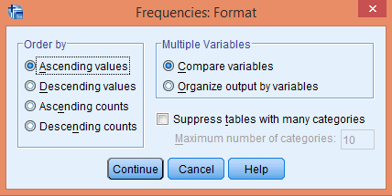
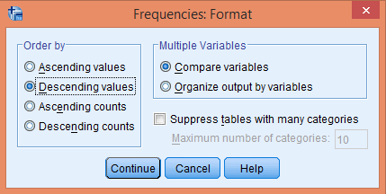

Slide 17
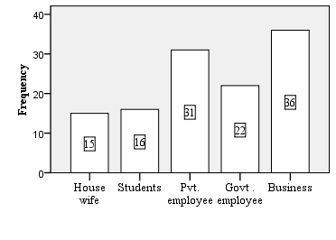
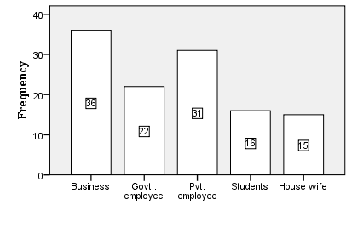
Frequency Formats
Figure 4.3a. Frequency: Ascending Values
Figure 4.3b. Frequency: Descending Values

Slide 18
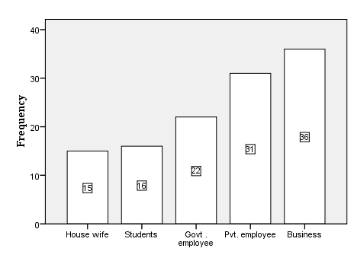
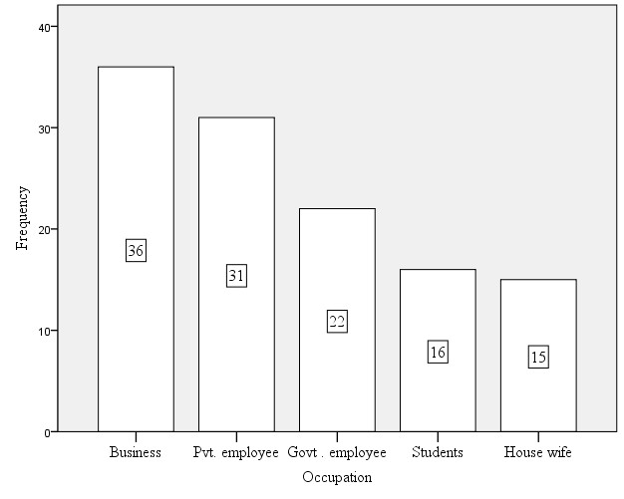
Figure 4.3a. Frequency: Ascending Counts
Figure 4.3b. Frequency: Descending Counts

Slide 19
Computing Descriptive Statistics
Computing Percentiles
Quartile: A quartile is the first command of percentile that divides data into the 25th, 50th and 75th percentiles and produces results accordingly.
Exhibit 4.5. Use retail.sav » Menu bar » analyse » Descriptive Statistics » Frequencies » Select Distance and transfer to right-handed Variable(s) box » Statistics » Quartiles » Click OK

Slide 20
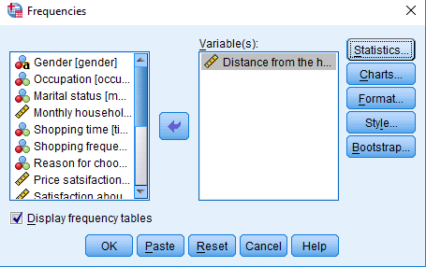
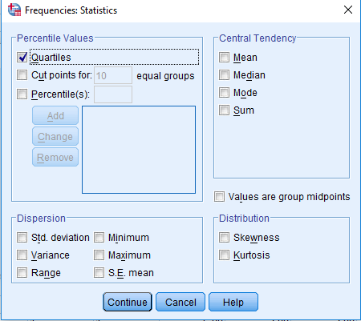

Slide 21
Table 4.2. Quartile for Distance
Percentiles
25th | 50th | 75th
4.0 | 5.0 | 7.0
Cut points: The next option, cut point, is used to divide data set into equal intervals of percentiles according to the value assigned.

Slide 22
Table 4.3. Percentiles of Distance: Cut Point 10
Percentiles
10th | 20th | 30th | 40th | 50th | 60th | 70th | 80th | 90th
3.0 | 4.0 | 4.0 | 5.0 | 5.0 | 6.0 | 7.0 | 8.0 | 10.0
Table 4.4. Percentiles of Distance: Cut Point 5
Percentiles
20th | 40th | 60th | 80th
4.0 | 5.0 | 6.0 | 8.0

Slide 23
Percentiles for a Specific Value: The specific percentile values for a particular variable in a data set could not be accessed with the two options discussed earlier.
Exhibit 4.6. Frequencies: Statistics » Percentile(s) » (Type) 45, 65 and 78 (one-by-one and use Add option in each step) » Click OK

Slide 24
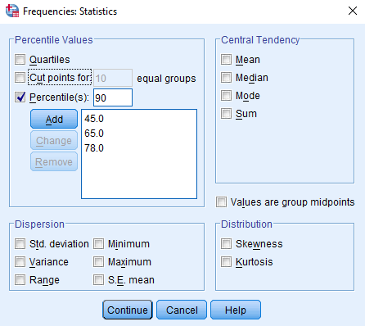
Table 4.5. Specific Percentiles of Distance
45th | 65th | 78th
5.0 | 7.0 | 8.0

Slide 25
Central Tendency
Exhibit 4.7. Use retail.sav » Menu bar » Analyse » Descriptive statistics » Frequencies » Select Display and transfer to right-handed variable(s) box » Statistics » Central Tendency » (select) Mean, Median, Mode and Sum » OK
Table 4.6. Central Tendency for Display
Mean | Median | Mode
5.4 | 5.5 | 8.0

Slide 26
Dispersion of Data Distribution
Skewness
The skewness presents the extent of spread in the data around the mean and affects the shape of normal probability distribution. The magnitude of skewness confirms the asymmetry of statistical distribution and indicates the deviation from the normality. The asymmetry in the normal distribution reveals in forms of negative or positive skewness.

Slide 27
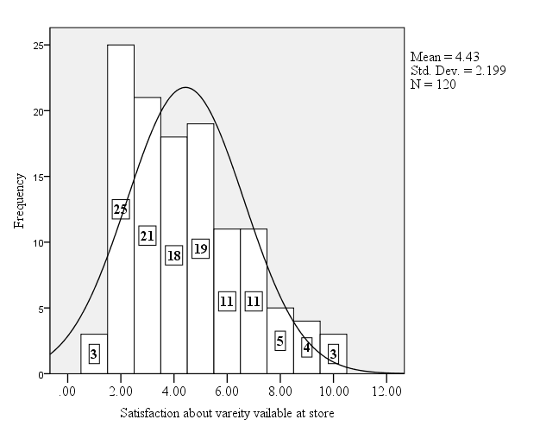
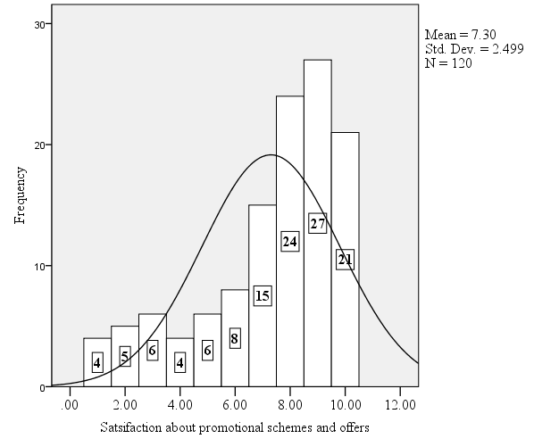
Figure 4.4a. Positively Skewed
Figure 4.4b. Negatively Skewed

Slide 28
Kurtosis
Kurtosis is an indicator of flatness or peakiness in data distribution and indicates whether the spread of data is far from or closer to the mean. The value of kurtosis varies according to the values concentrated around the mean.

Slide 29
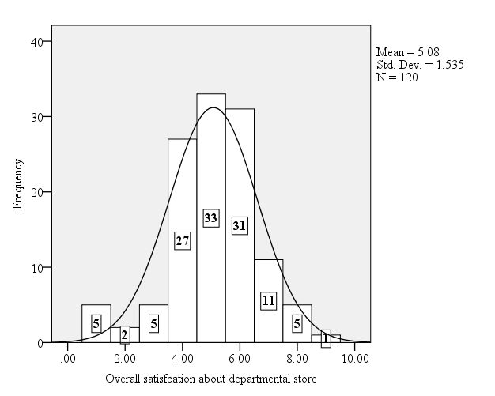
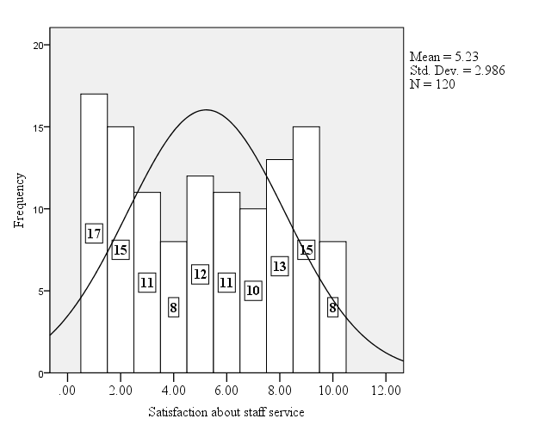
Figure 4.5a. Leptokurtic Distribution
Figure 4.5b. Platykurtic Distribution

Slide 30

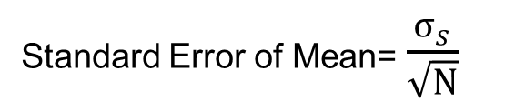
Dispersion: The extent of similarity or dissimilarity in a data set can be explained by measuring the dispersion. The range, standard deviation, variance, and standard error of means are the most used measures for dispersion. Range = X_{largest} – X_{smallest}
Variance σ² = Σ (X_{i} – μ)
N

Slide 31
Table 4.7. Measures of Dispersion
Statistics | Staff Service | Overall | Statistics | Staff Service | Overall
Standard error of mean | 0.27 | 0.14 | Variance | 8.9 | 2.3
Standard Deviation | 2.98 | 1.53 | Range | 9.0 | 8.0

Slide 32
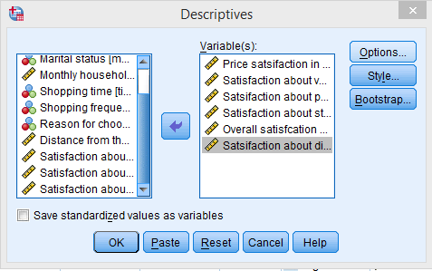
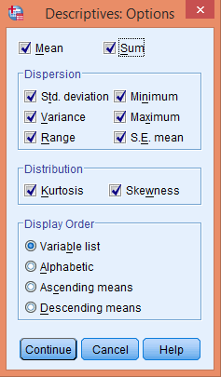
Direct Commands for Descriptive Statistics
Exhibit 4.8. Use retail.sav » Menu bar » analyse » Descriptive statistics » Descriptives » Select Price, Variety, Promotion, Staff service, Overall satisfaction and Display and transfer to the right-handed variable(s) box » Options » (select) Mean, Sum, Std. deviation, Variance, Range, S.E. mean, Skewness and Kurtosis » Variable list » Click OK

Slide 33
Table 4.8. Descriptive Statistics
Statistics | Price | Variety | Promotion | Staff Service | Overall | Display
Range | 9 | 9 | 9 | 9 | 8 | 9
Sum | 679 | 532 | 876 | 627 | 609 | 649
Mean | 5.65 | 4.43 | 7.30 | 5.22 | 5.07 | 5.40
Standard error of mean | 0.233 | 0.200 | 0.228 | 0.272 | 0.140 | 0.242
Standard deviation | 2.56 | 2.19 | 2.49 | 2.98 | 1.53 | 2.65
Variance | 6.56 | 4.83 | 6.24 | 8.91 | 2.35 | 7.06
Skewness | −0.042 | 0.653 | −1.04 | 0.031 | −0.440 | −0.098
Kurtosis | −0.737 | −0.296 | 0.165 | −1.36 | 0.846 | −1.08

Slide 34
Scale Requirement for Frequency Analysis and Descriptive Statistics
Task | Number of Variables Required | Pattern of Displaying the Variables | Required Scale
Frequency analysis through simple bar chart | 2 | Independent variable (1) on x-axis; Dependent variable (1) on y-axis | Independent variable: Nominal (with at least two categories) Dependent: Metric
Frequency analysis through pie chart | 2 | Independent variable (1) appears as slices corresponding to dependent variable (1) | Independent variable: Nominal based multiple category Dependent: Metric
Frequency analysis through histogram | 1 | Dependent variable (1) appears on y-axis | Dependent variable: Metric
Percentiles and quartiles | As per the requirement | Tabular form | Interval and ratio
Mean |  |  | Interval and ratio
Median |  |  | Ordinal (Rank based)
Mode |  |  | Nominal (consisting of different categories)
Standard deviation, variance and range |  |  | Interval and ratio
Skewness and kurtosis |  |  | Interval and ratio

Slide 35
Key Terms
Bar chart Central tendency (mean, median, mode) Dispersion (Inter quartile range, standard deviation variance, and standard error of mean) Distribution (skewness, and kurtosis) Frequency Analysis Histogram (Bins and scales) | Measurement Scales (nominal, ordinal, interval and ratio) Normal Distribution Percentile Pie chart Quartiles (25th percentile, 50th percentile, 75th percentile)

